Slide 1
Computer Vision

Slide 2
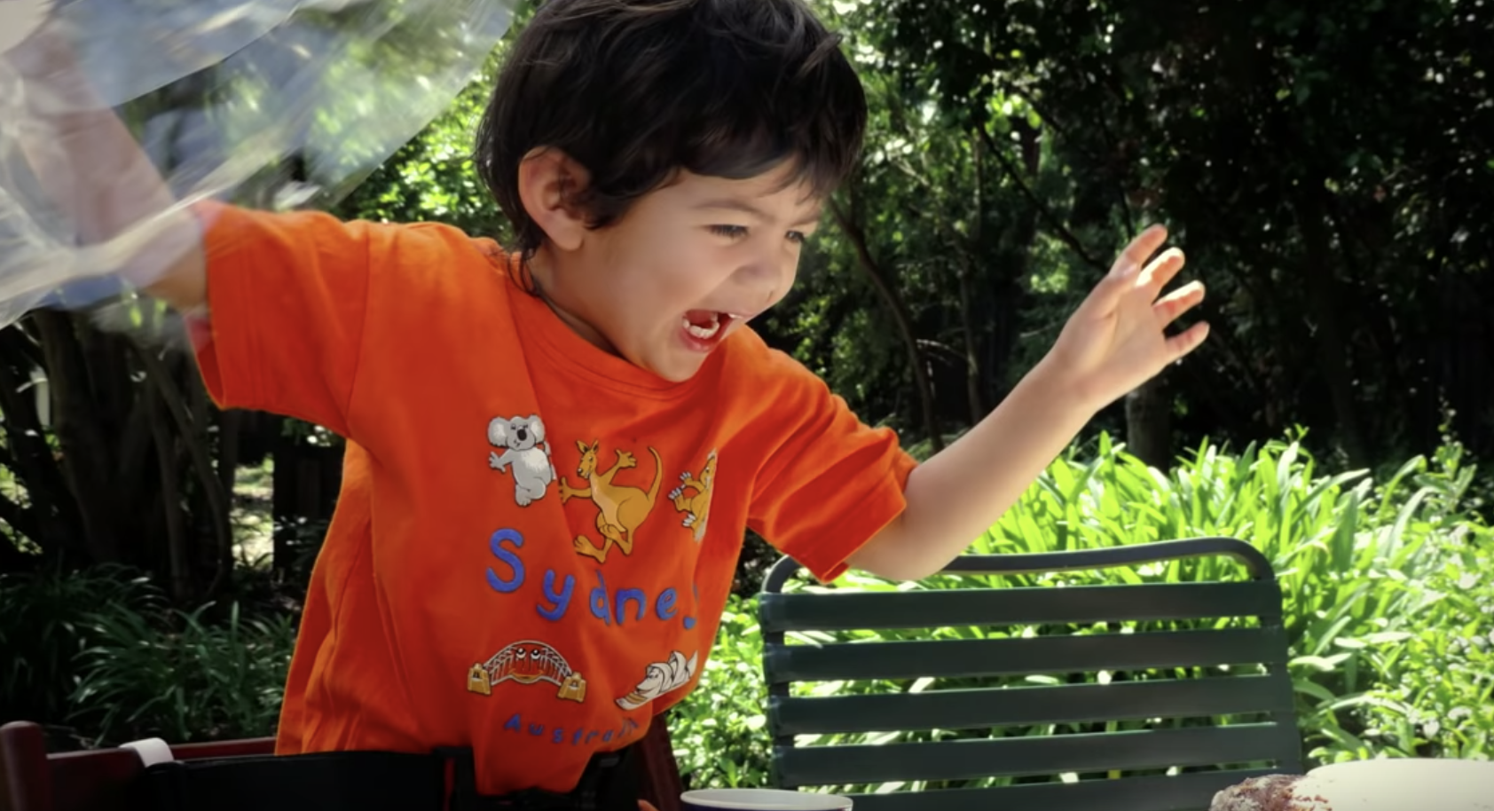
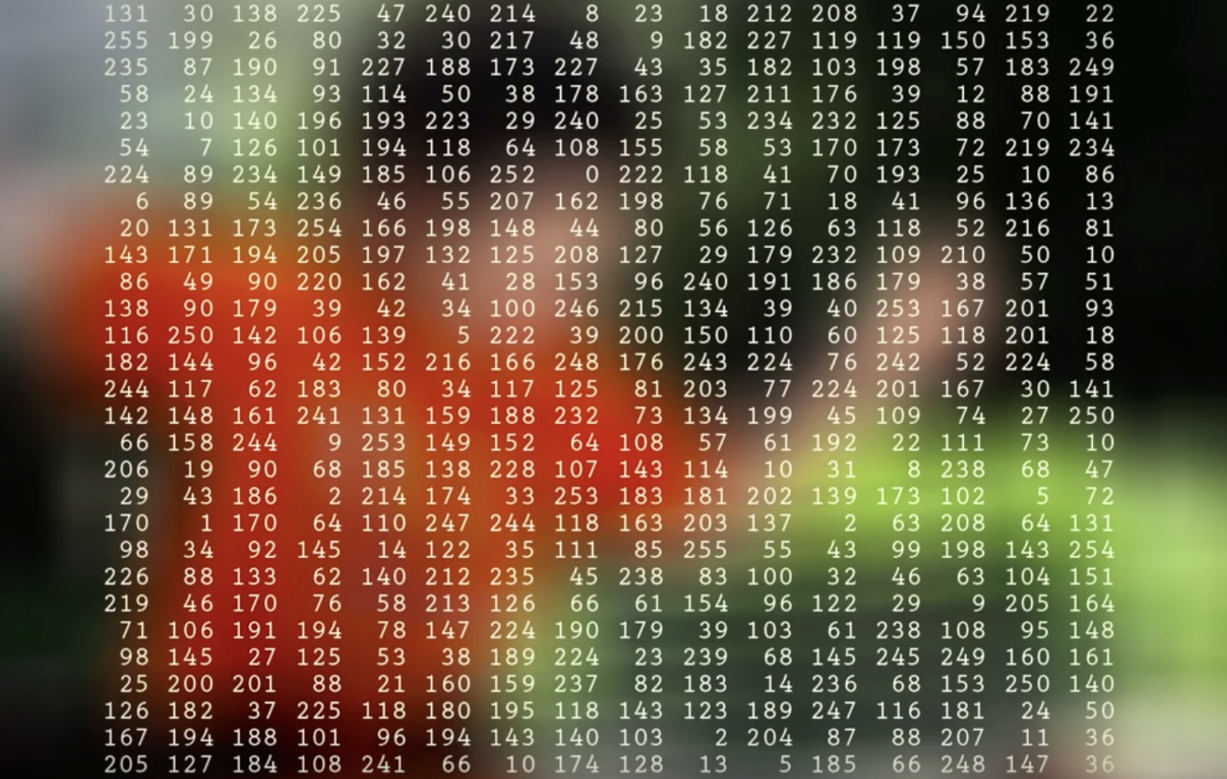
Goal of computer vision
To bridge the gap between pixels and “meaning”
What we see what a computer sees

Slide 3
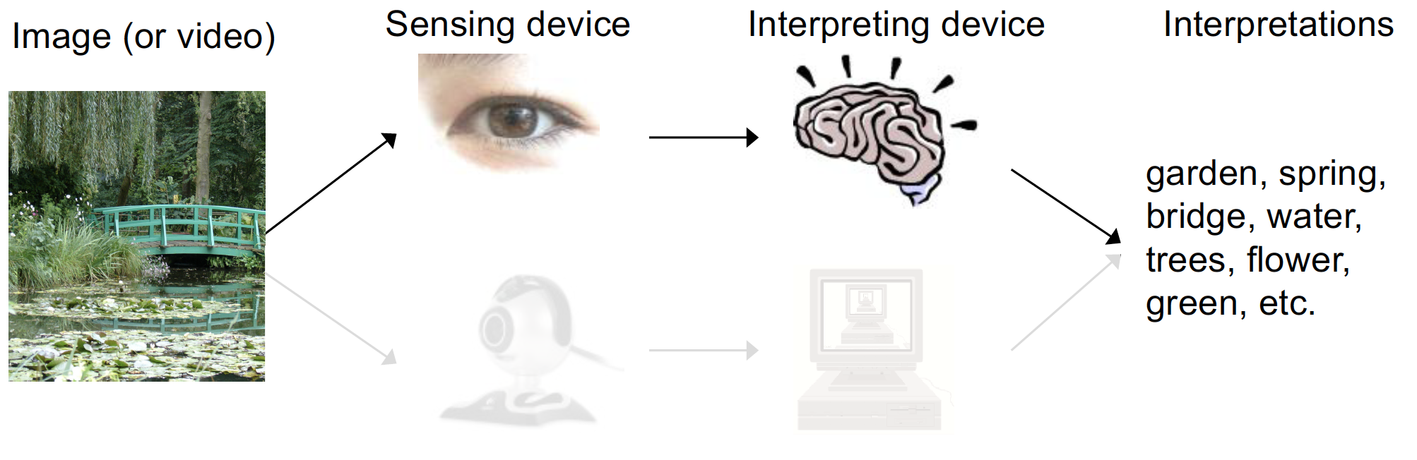
What is (computer) vision?

Slide 4
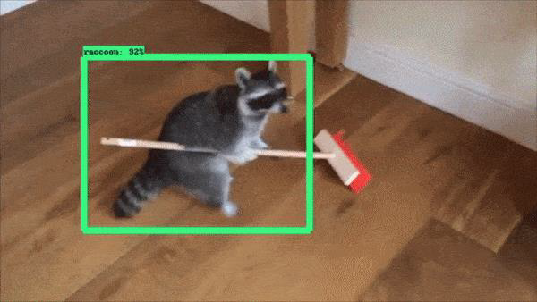
What is computer vision?
Allowing robots and machines to see the world around them.

Slide 5
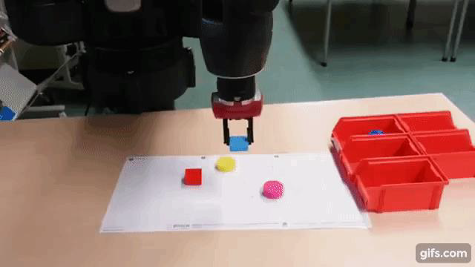
What is computer vision?
Once robots can see the world, they can interact with it.

Slide 6
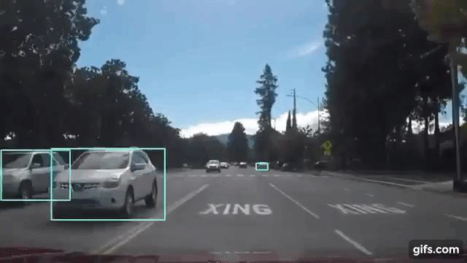
What is computer vision?
Machines can learn to perform tasks just like humans.

Slide 7
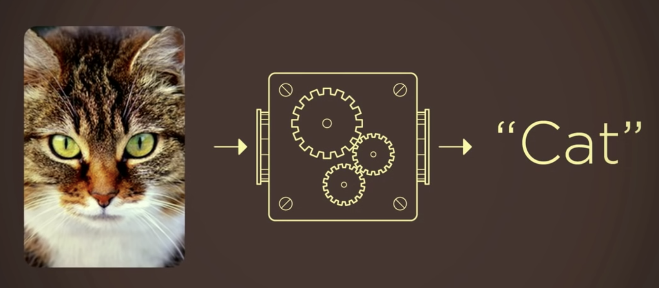
How did computer vision work?

Slide 8
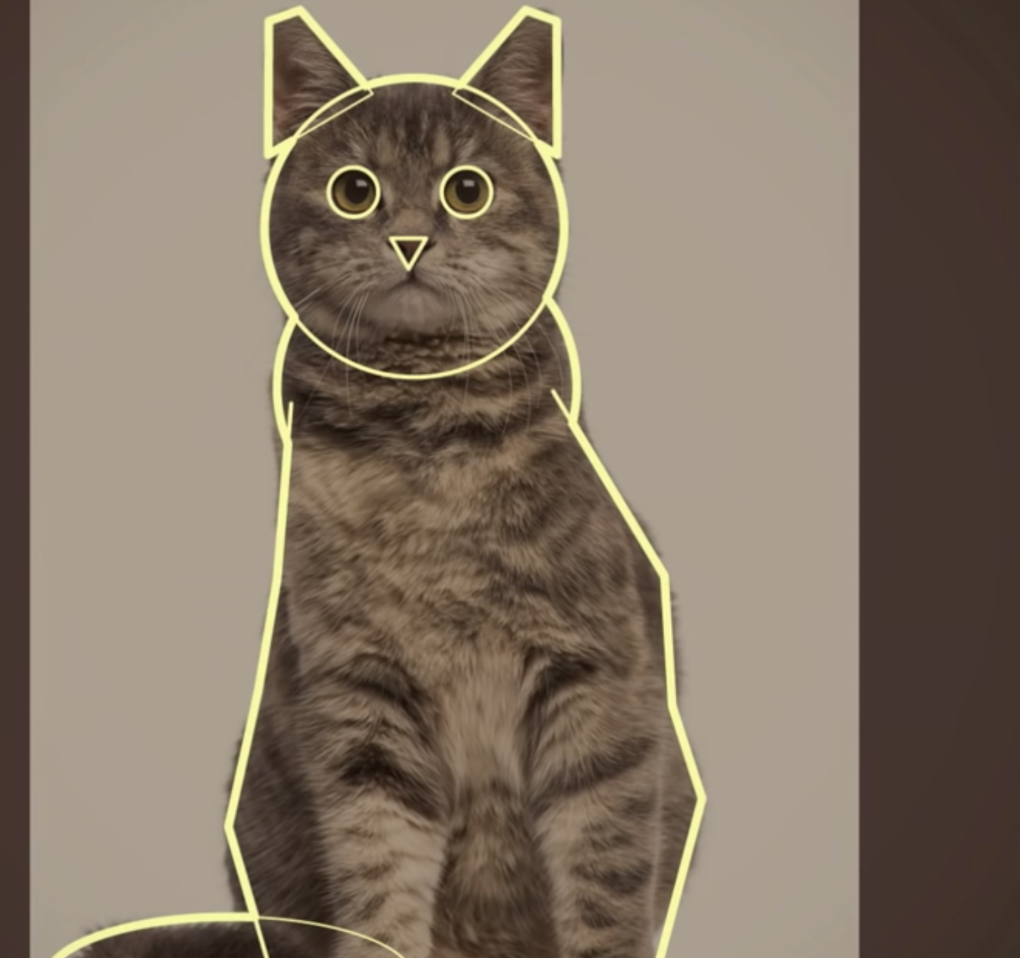
How did computer vision work?

Slide 9
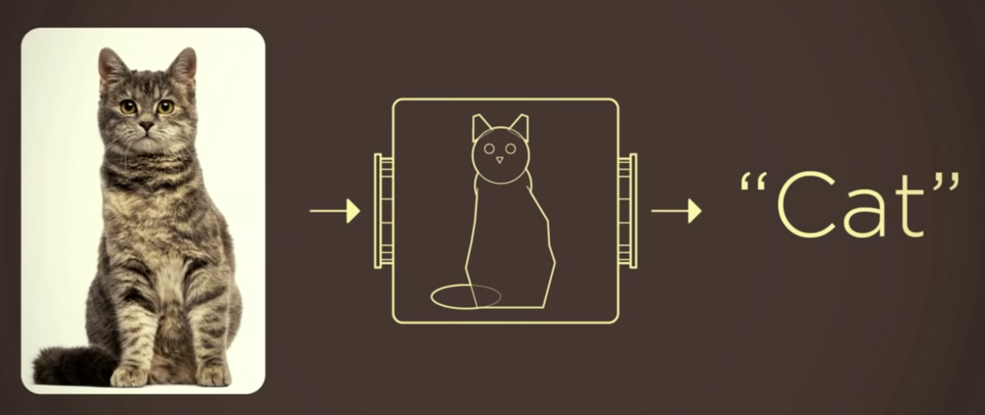
How did computer vision work?

Slide 10

Why computer vision so hard?

Slide 11
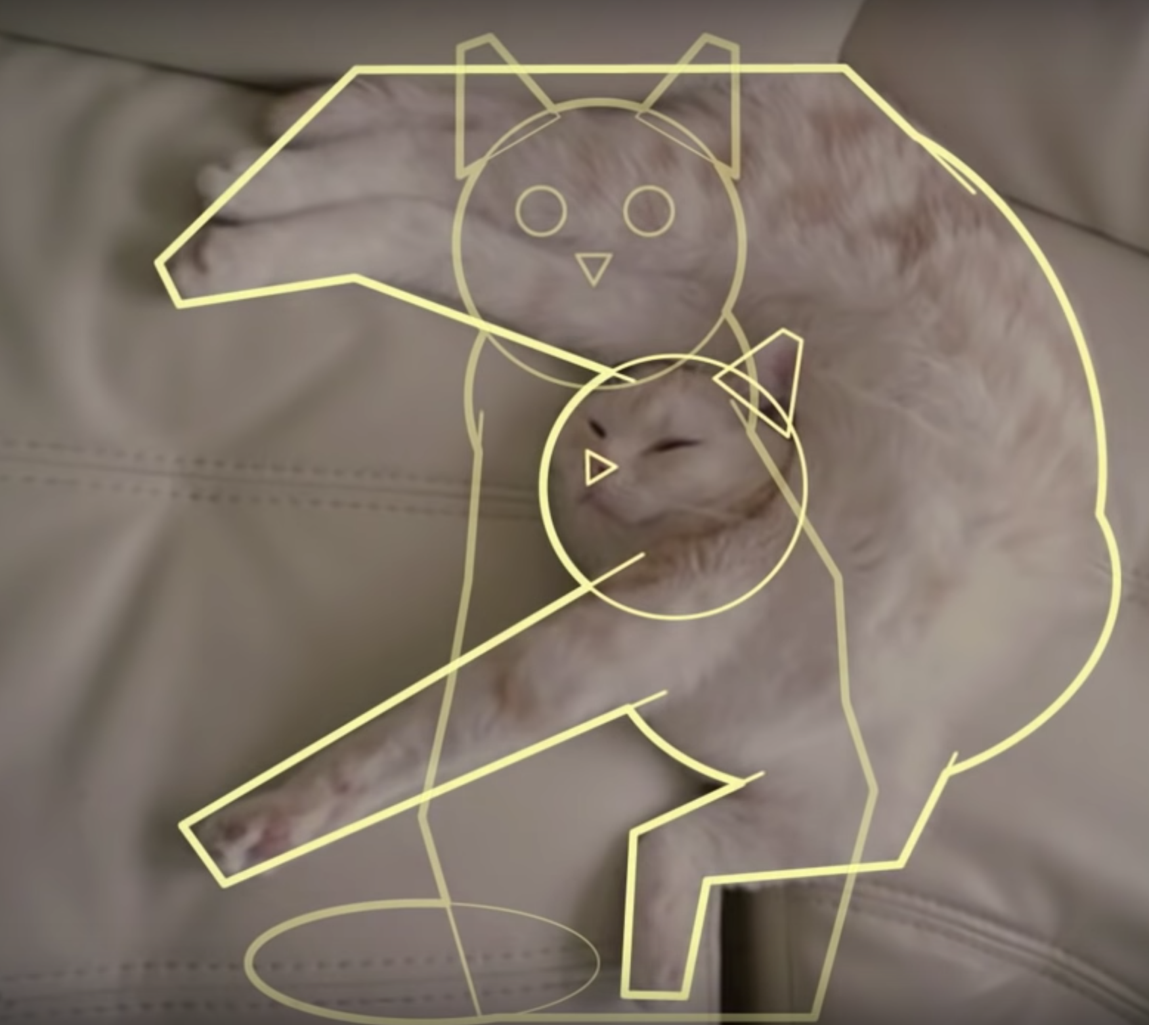
Why computer vision so hard?

Slide 12
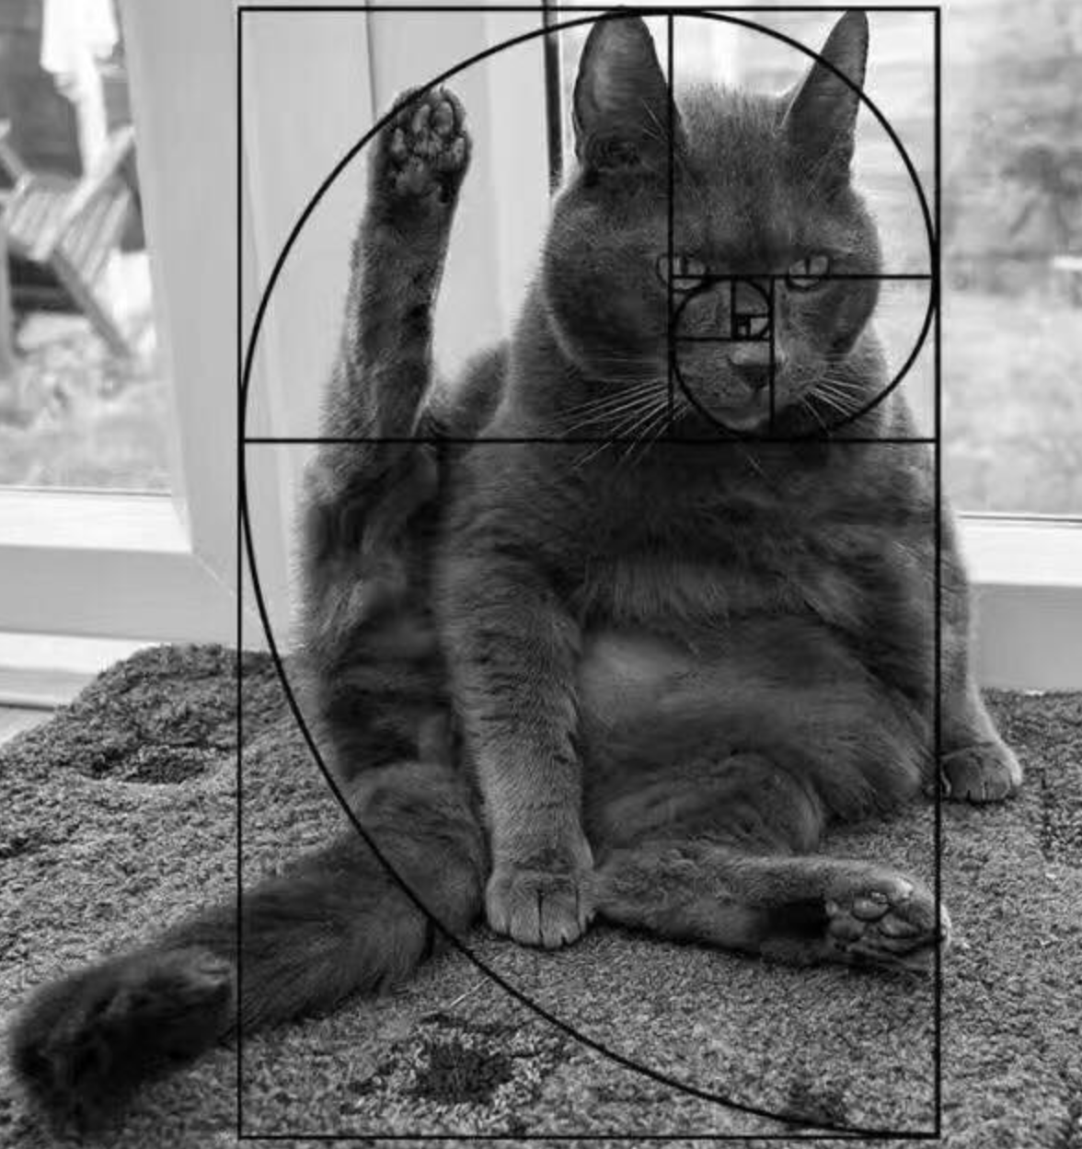
Why computer vision so hard?

Slide 13
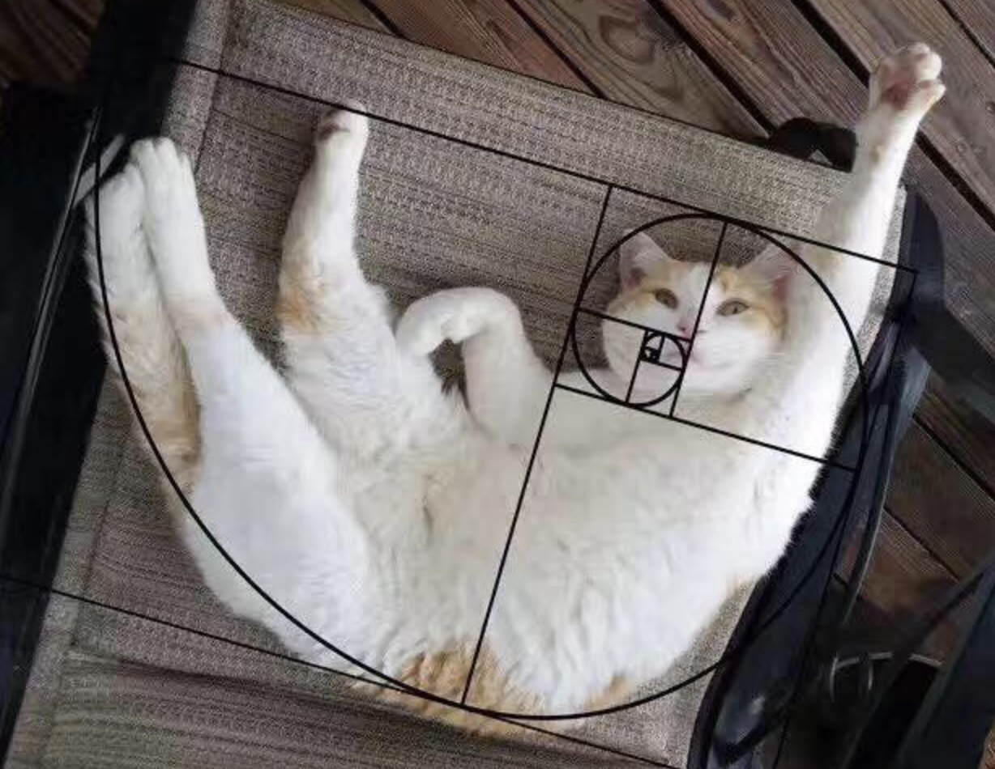
Why computer vision so hard?

Slide 14
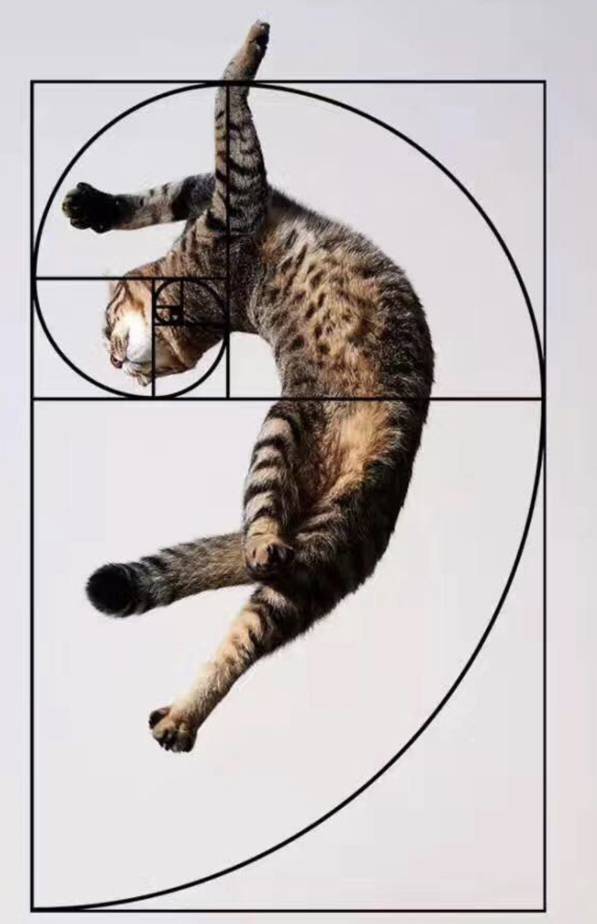
Why computer vision so hard?

Slide 15

Why computer vision so hard?
“Even something as simple as a household pet
can present an infinite number of variations to the object model,
and that's just one object.”
-- Fei Fei Li

Slide 16
How does (computer) vision work?

Slide 17
How does computer vision work?
Now, we have the data to nourish our computer brain

Slide 18
How does computer vision work?
Then we're ready to come back to the algorithms themselves

Slide 19
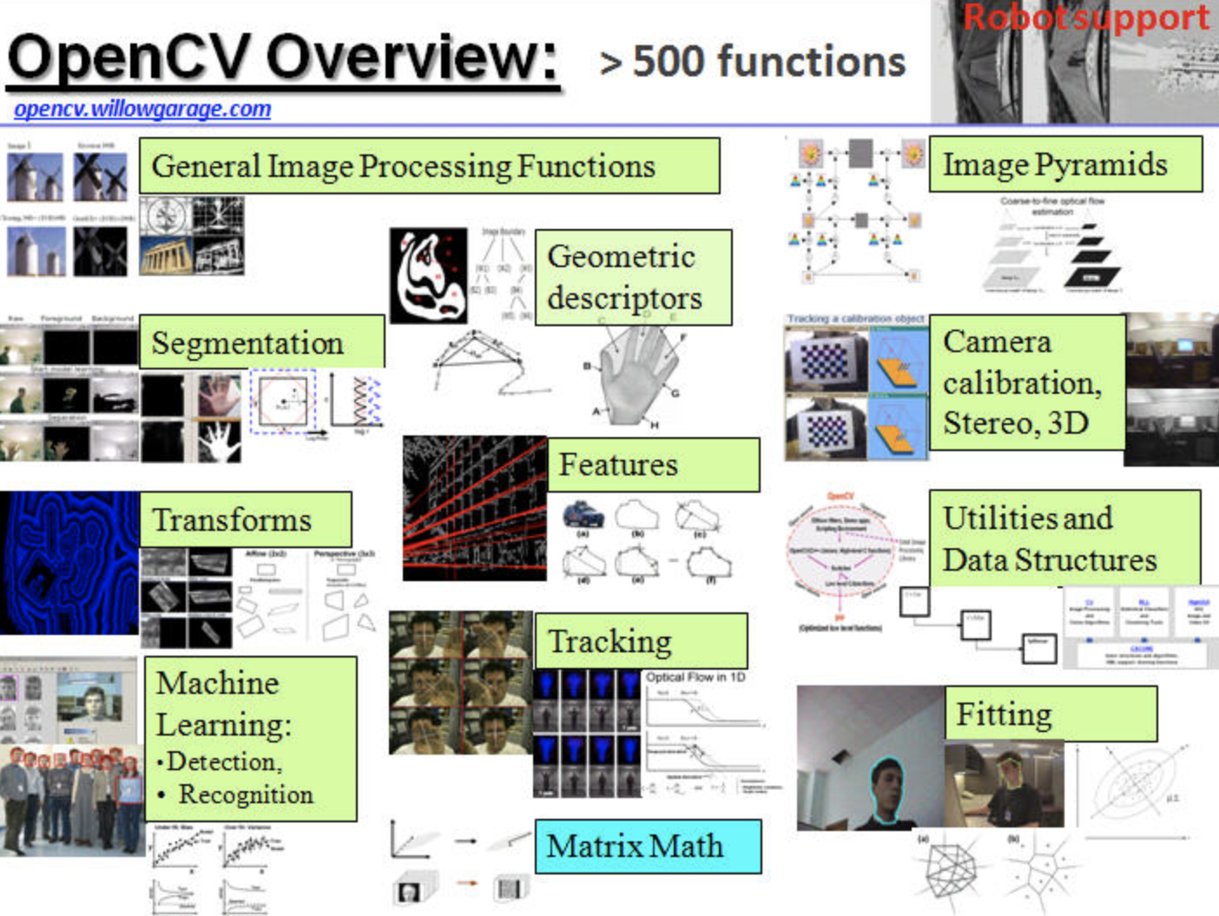
How does computer vision work?
1. OpenCV

Slide 20
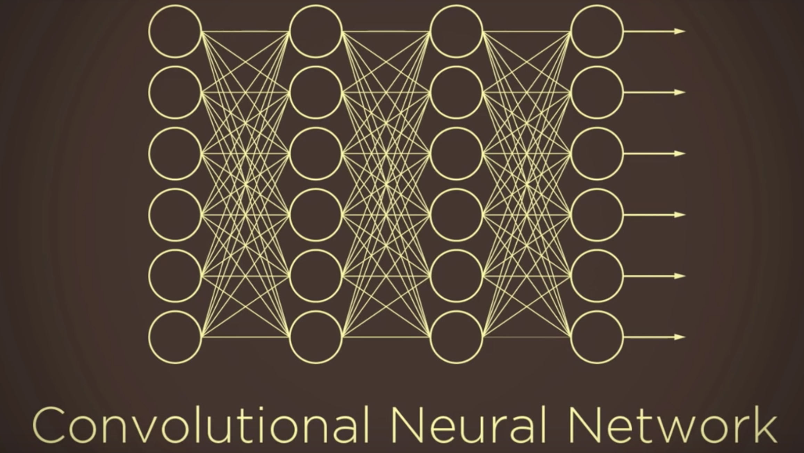
How does computer vision work?
2. CNN

Slide 21
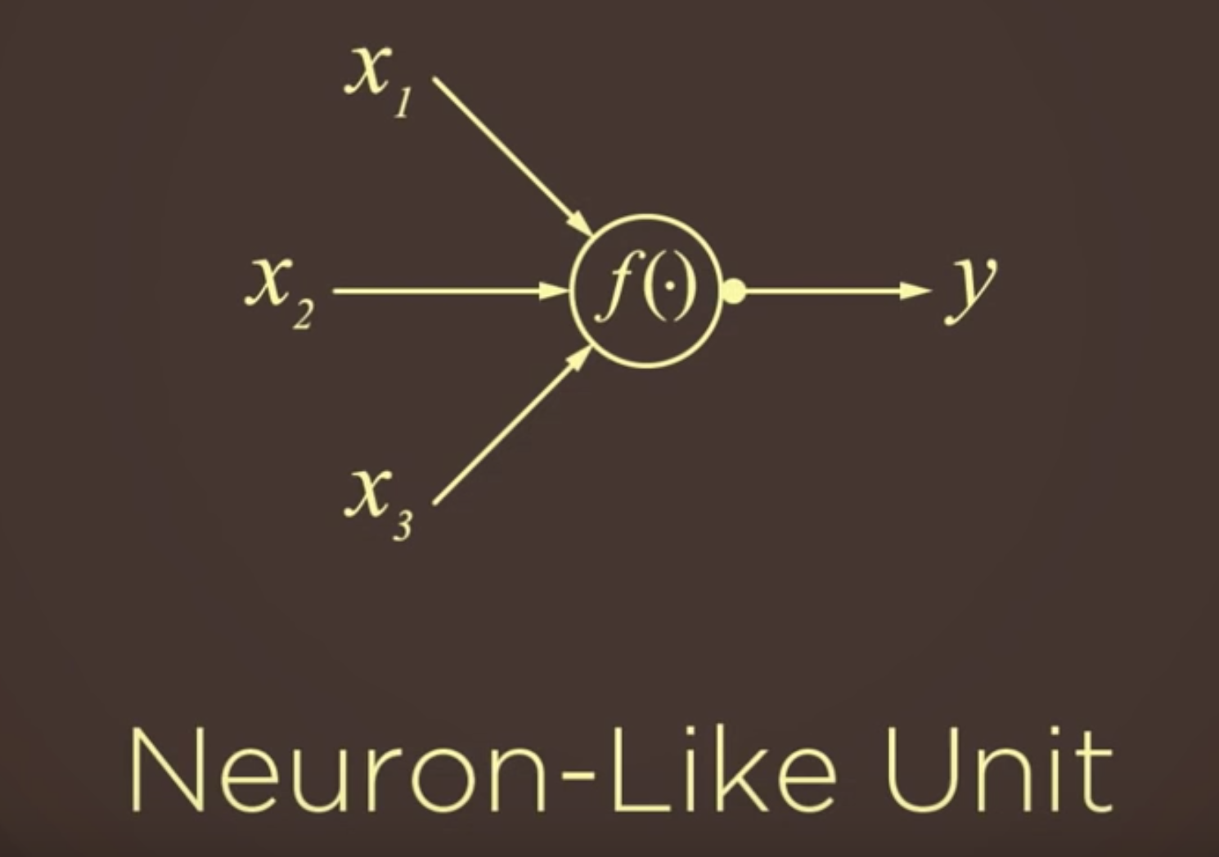
How does computer vision work?

Slide 22
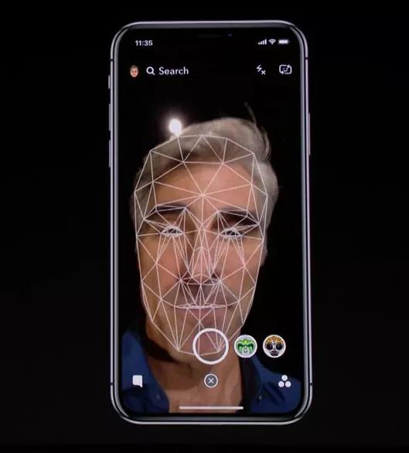
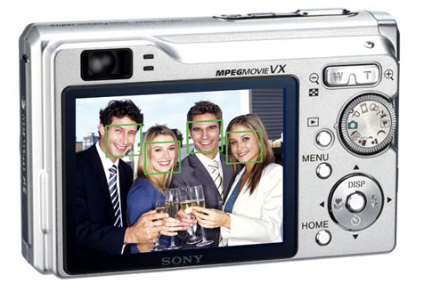
Real world
Apple Face ID (Face Recognition For Security ) digital cameras now detect faces (Face Detection)

Slide 23
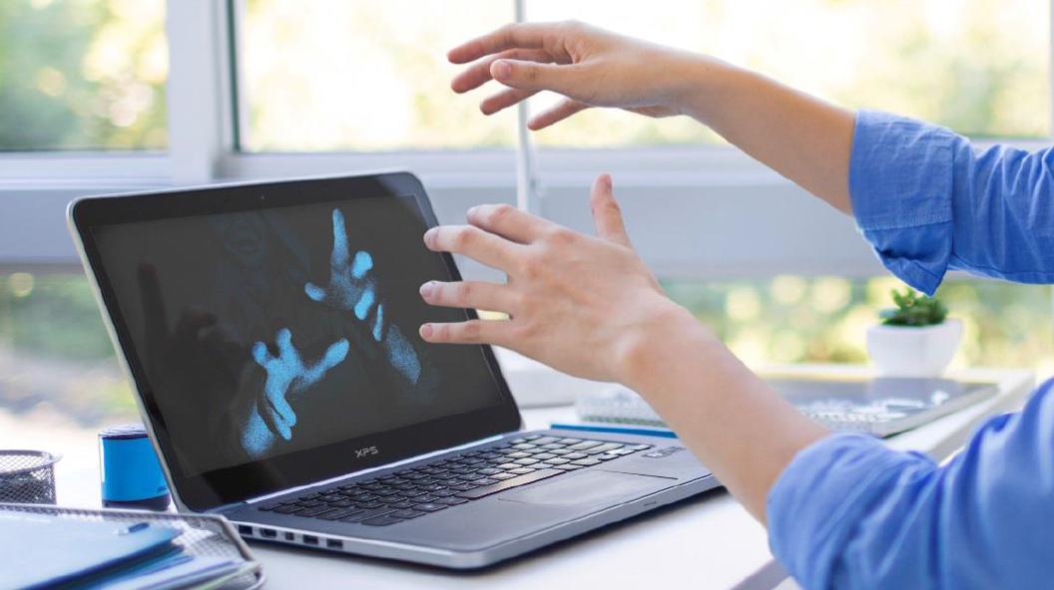
Real world
Gesture Recognition
Leap Motion, Realsense

Slide 24
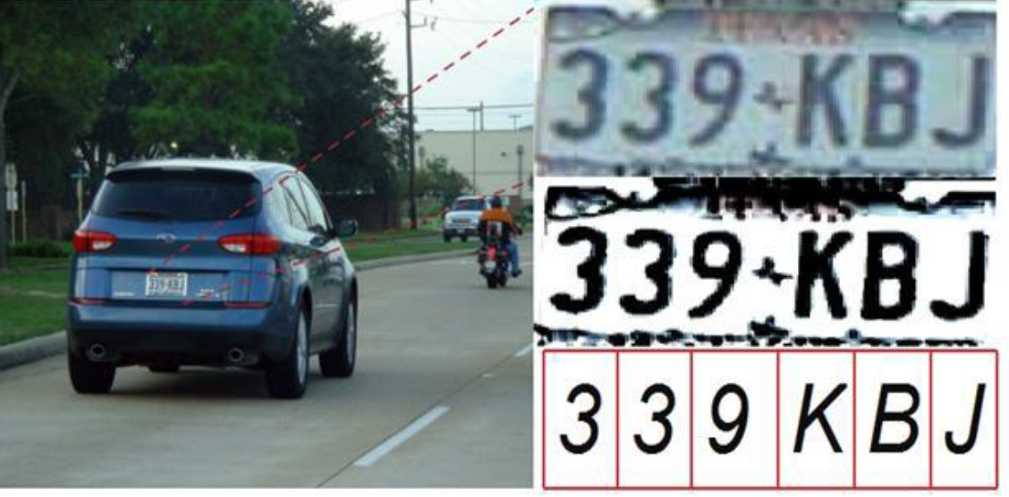
Real world
Optical Character Recognition (OCR)
(Technology to convert scanned docs to text)

Slide 25
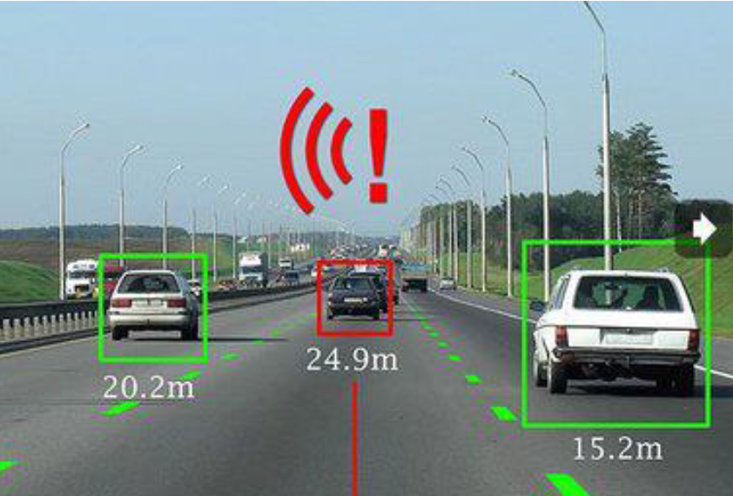
Real world
Traffic Monitoring , Augmented Driver Assist Systems

Slide 26
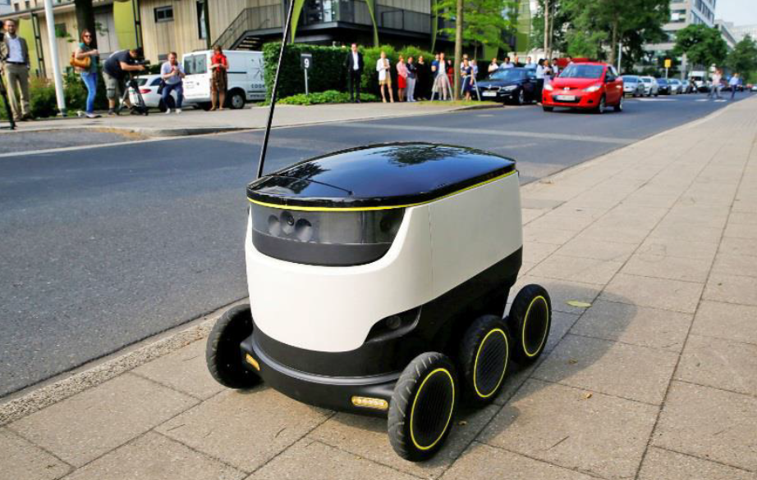
Real world
Navigation

Slide 27
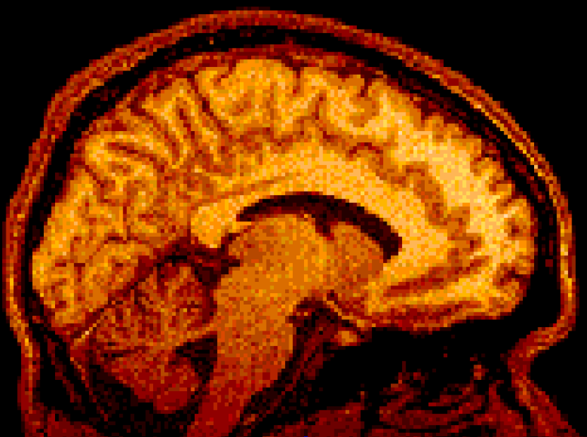
Real world
Brain Imaging MRI
Researchers have tested an AI that can detect neurological illnesses by reading CT scan images faster than radiologists.

Slide 28
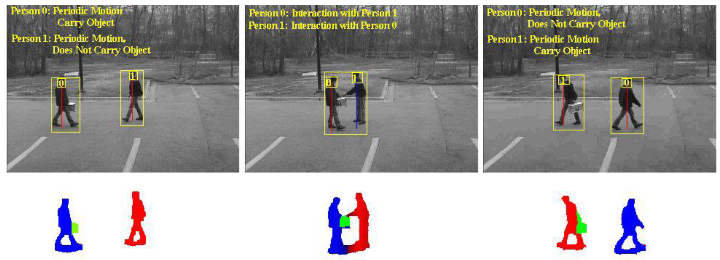
Real world
Human Activity Recognition

Slide 29
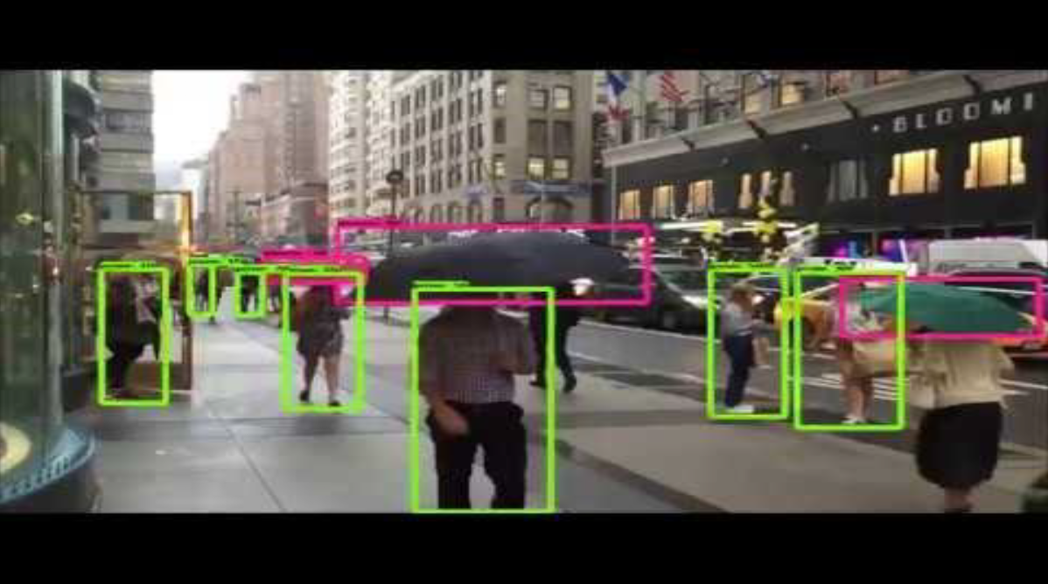
Real world
Video Surveillance and Tracking

Slide 30
Difficulties
Computation power
01
It is computationally intensive.
Video -> Real time -> Speed
02
Usually requires high end processors or graphics cards to achieve real time performance.
03
GPU, TPU, ASIC, FPGA...

Slide 31
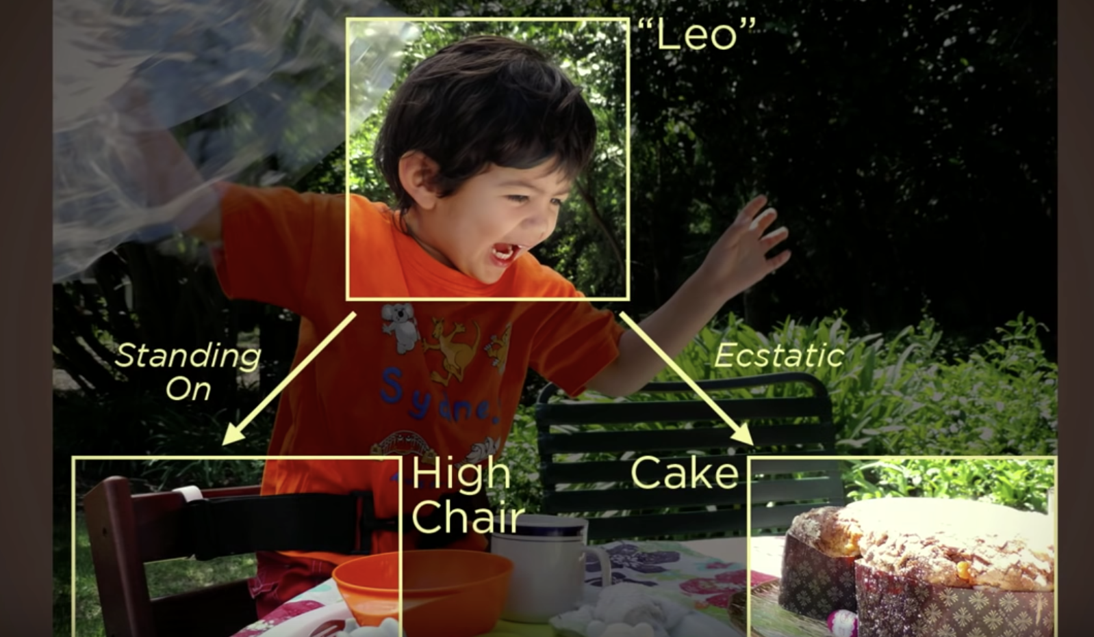
Problems
Scene understanding
Generalization

Slide 32
Future
Computer vision be used with other technologies:
Eg. For visually challenged people, image captioning applications can be combined with natural language generation (NLG) to interpret the objects in the surroundings
01
02
Computer vision will also play a vital role in the development of artificial general intelligence (AGI) and artificial superintelligence (ASI) by giving them the ability to process information as well as or even better than the human visual system.

Slide 33
Challenge
The future of computer vision will pave the way for artificial intelligence systems that are as human as us. However, before doing so, there is a big challenge that must be overcome, the demystification of the black box of AI. That’s because just like other deep learning applications, computer vision, while being functionally effective, is undecipherable when it comes to its inner workings.

Slide 34
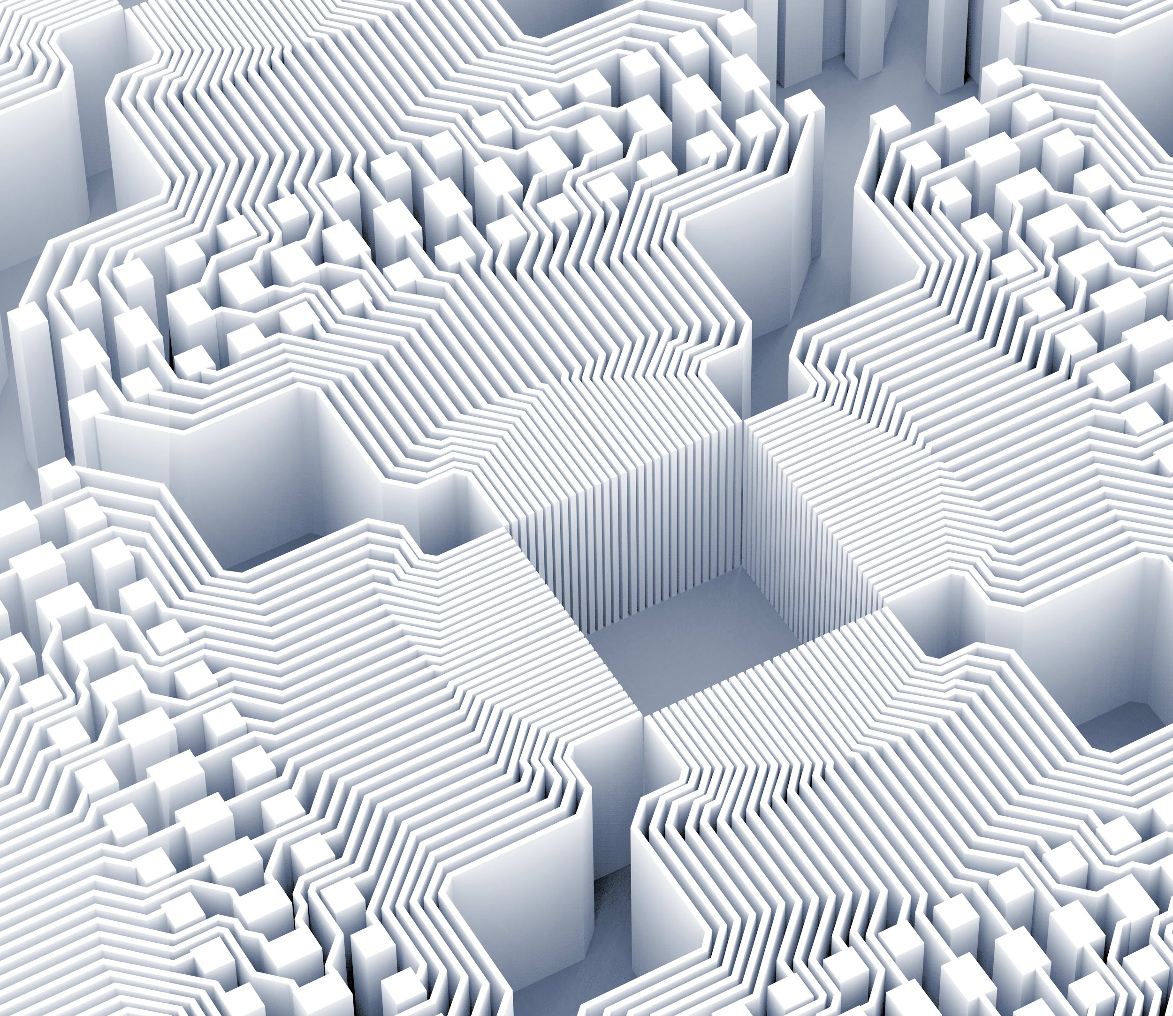
Thank you!
Resources:
How we teach computers to understand pictures | Fei Fei Li
RODNEY DOCKTER, PH.D.
The Present And Future Of Computer Vision, by Naveen Joshi
https://www.forbes.com/sites/cognitiveworld/2019/06/26/the-present-and-future-of-computer-vision/#6c453cec517d

